Slide 1

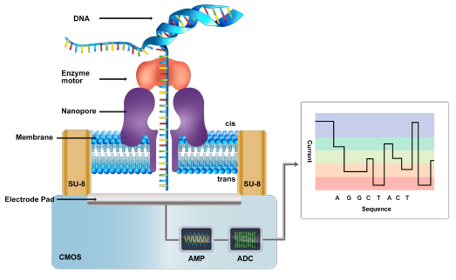
Low-Power and Scalable System on Chip for 3rd Generation of Nanopore-Based DNA Sequencing
Team Members:
Prof. Sebastian Magierowski (Supervisor)
Yunus Dawji (Ph.D. Student)
Sepideh Asgari (Ph.D. Student)
Amin Savari (Ph.D. Student)
Amirhossein Mohammadpanah (Master’s Student)
York University – Electrical Engineering and Computer Science-Canada

Slide 2

Introduction
DNA Sequencing
Sequencing a DNA sample according to the pico-ampere-sized current fluctuations induced by the passage of a DNA strand through a like-sized molecular sensor.
The sequence of bases: Adenine, Guanine, Cytosine, and Thymine
G T G T G A T C C A T G C A T G G A

Slide 3
Introduction
DNA moves through a nanopore protein and thus induces a small current signature indicative of the DNA’s structure.
Nanopore Sensor:
Biological Nanopore
Solid-State Nanopore
Notes:
The proposed DROIC system consists of an array of channels, capable of simultaneous amplification, filtering, and digitization of pico-ampere range current signals with sufficient accuracy and speed.

Slide 4
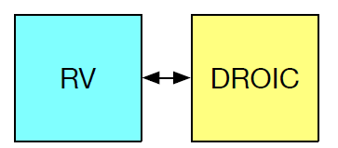
Project Motivation
There are at least two key components in our design:
A Mixed-Signal Array Digital Readout Integrated Circuit (DROIC)
A RISC-V Bioinformatics Processing Unit (BPU)
Goal: Integrating the scalable DROIC and the BPU onto a single die to perform the DNA sequencing.

Slide 5
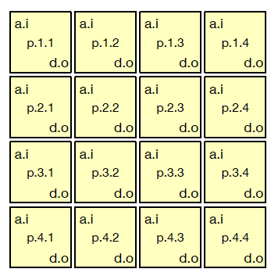
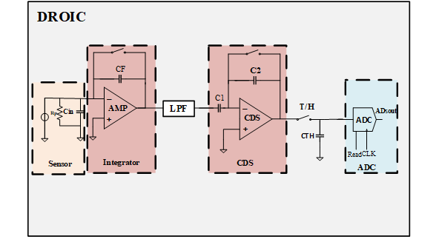
Project Overview
DROIC Block:
The circuit components used for the implementation of the readout channel [1]:
Integrator Filter Correlated Double Sampling 10-bit SAR_ADC

Slide 6
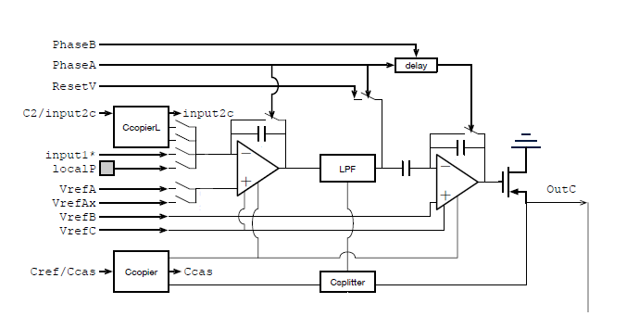
AFE
AFE completed blocks:
OTA
Csplitter
Ccopier
CcopierL

Slide 7
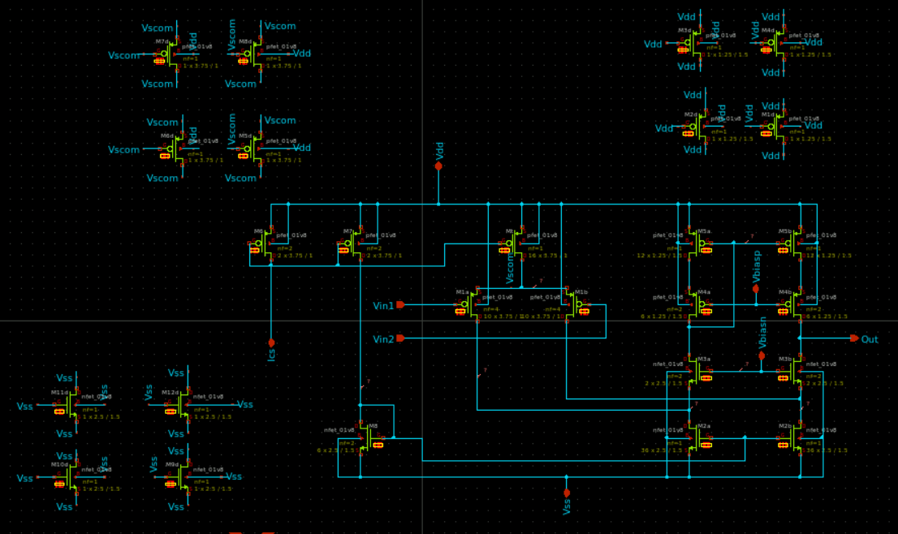
OTA Schematic
Designing folded-cascade OTA to use inside the Integrator and CDS structure.

Slide 8
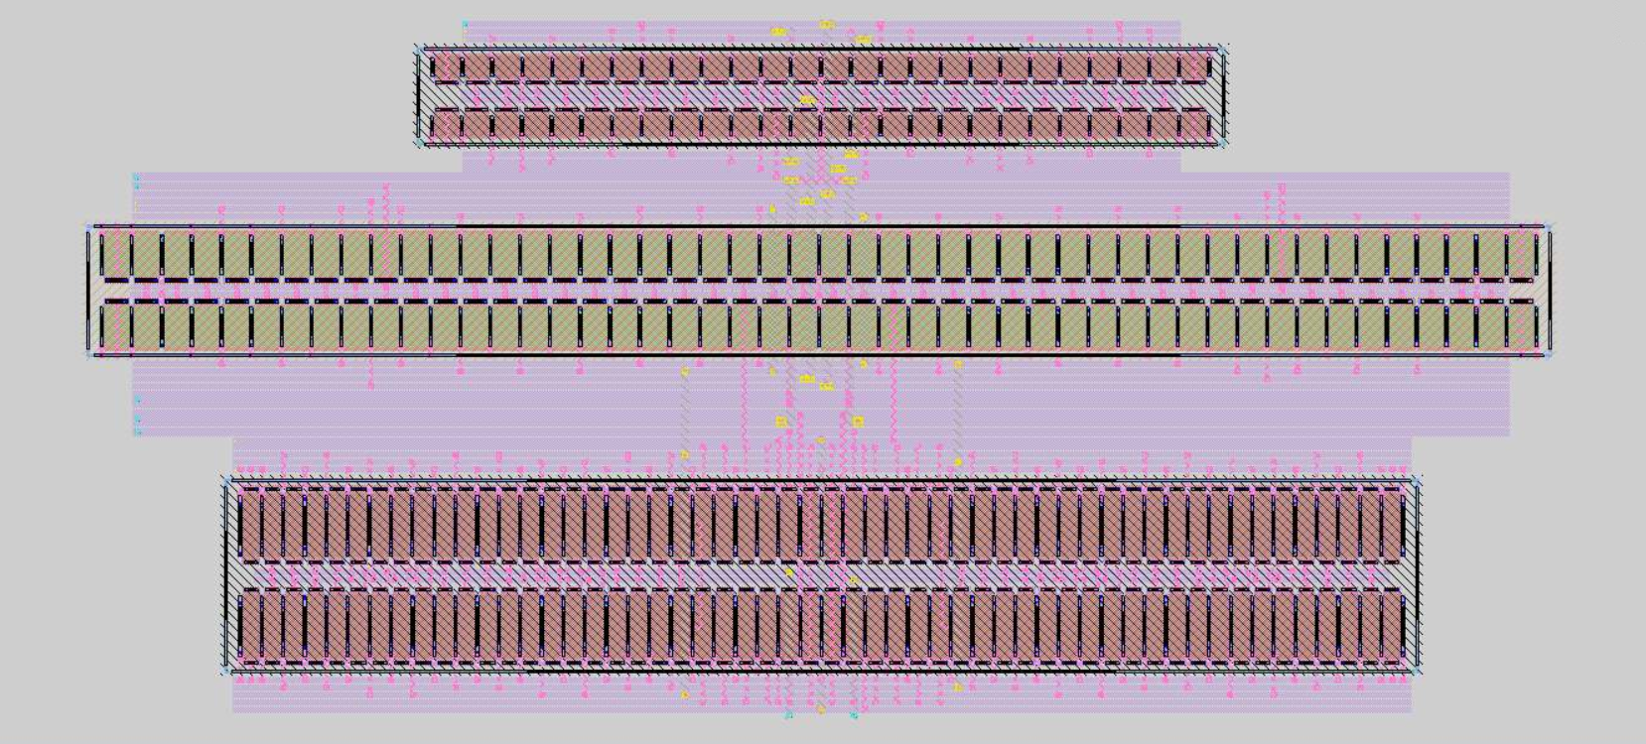
OTA Layout
This layout is designed based on the common centroid method

Slide 9
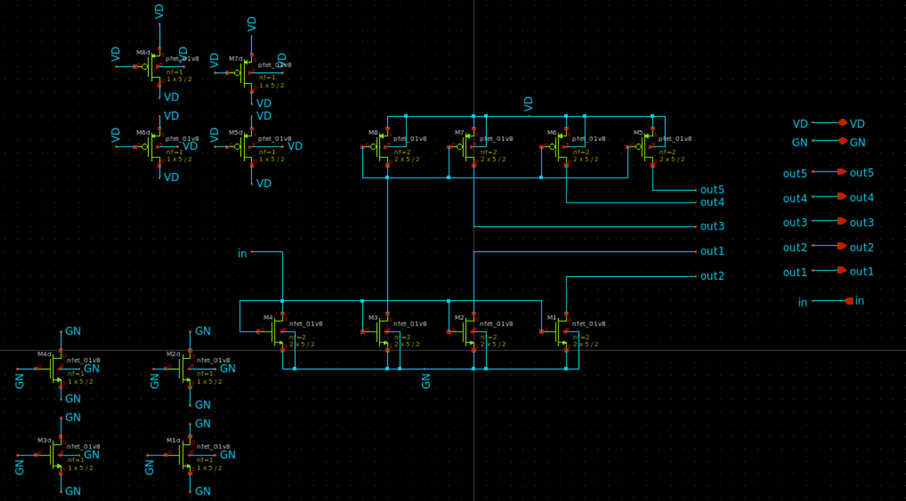
Ccopier Schematic
Ccopier circuit provides the reference current for the OTA.

Slide 10
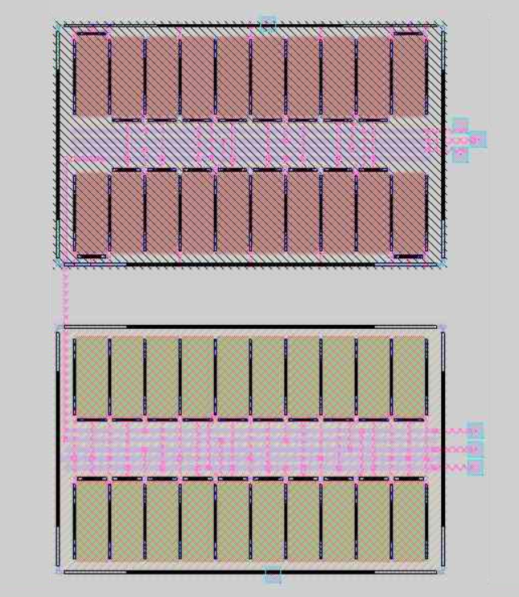
Ccopier Layout

Slide 11
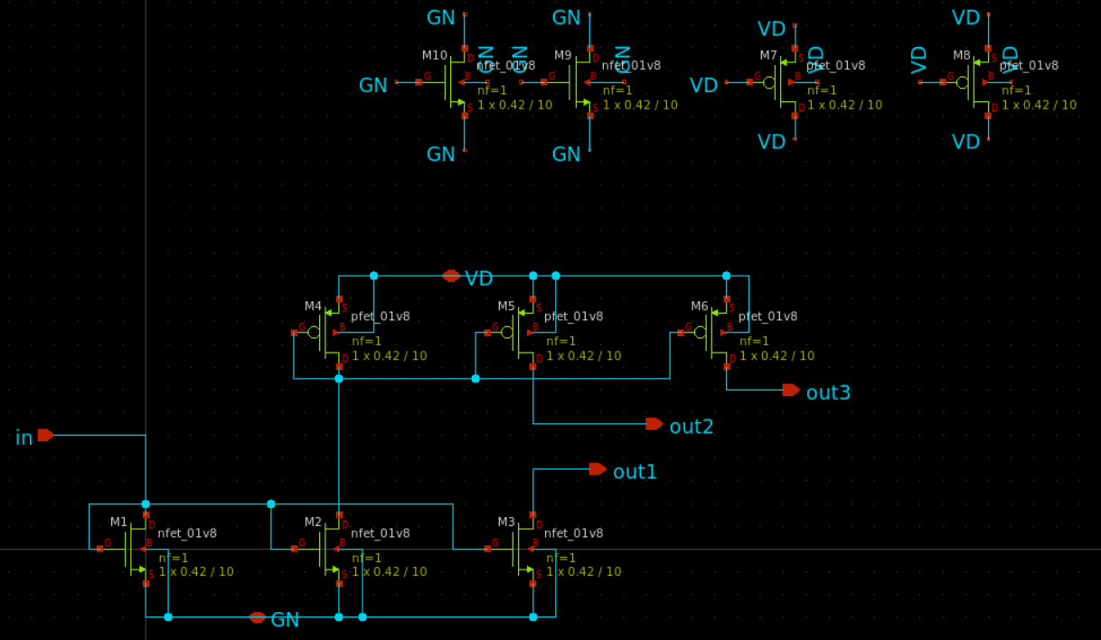
CcopierL Schematic
CcopierL simulates the input current ( input2c) for the integrator.

Slide 12
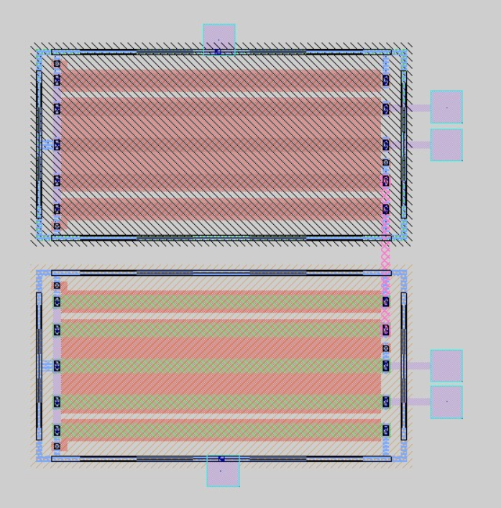
CcopierL Layout

Slide 13
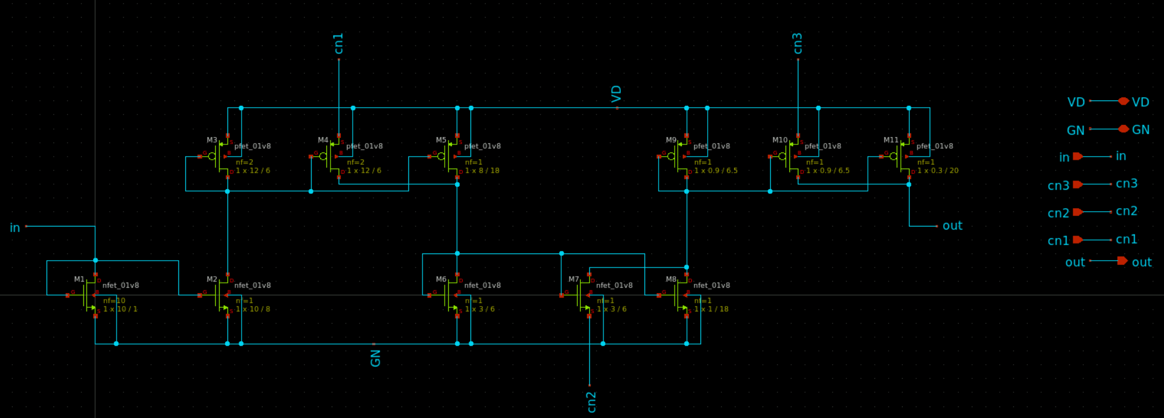
Csplitter Schematic
The provided current by Ccopier goes to LPF (Low-Pass Filter) through the Csplitter

Slide 14
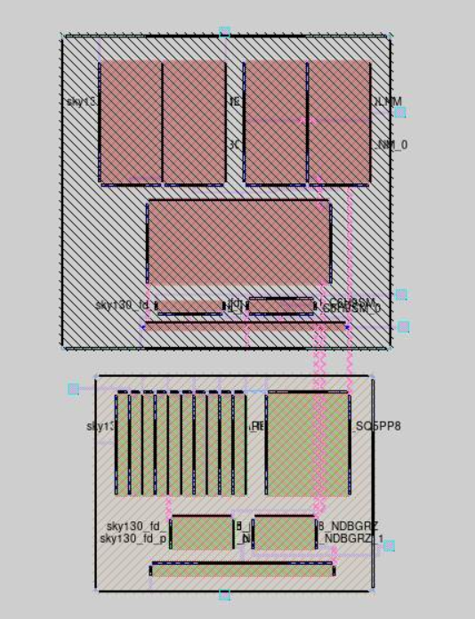
Csplitter Layout

Slide 15
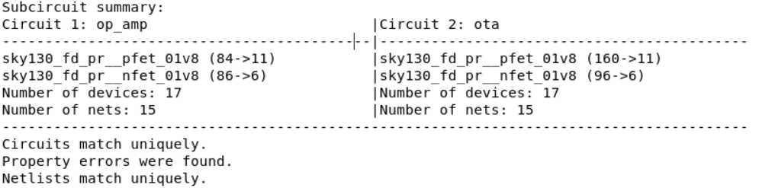
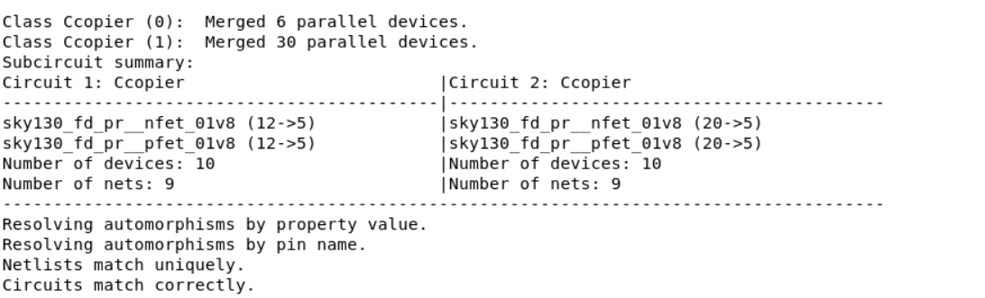

LVS for OTA, CcopierL, and Csplitter

Slide 16
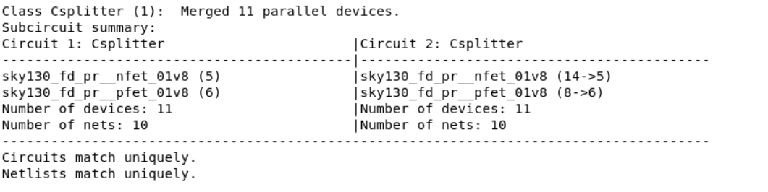
LVS for OTA, CcopierL, and Csplitter

Slide 17
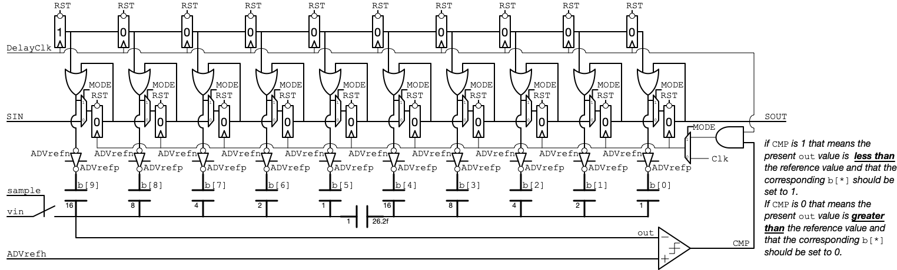
Capacitor-Bank
Top-Plate Sampling SAR ADC:
The complexity of the sample and hold operation can be reduced by directly sampling the input voltage on the top terminal [2].
Notes:
An Attenuator capacitor is used to split the array into two subarrays.

Slide 18
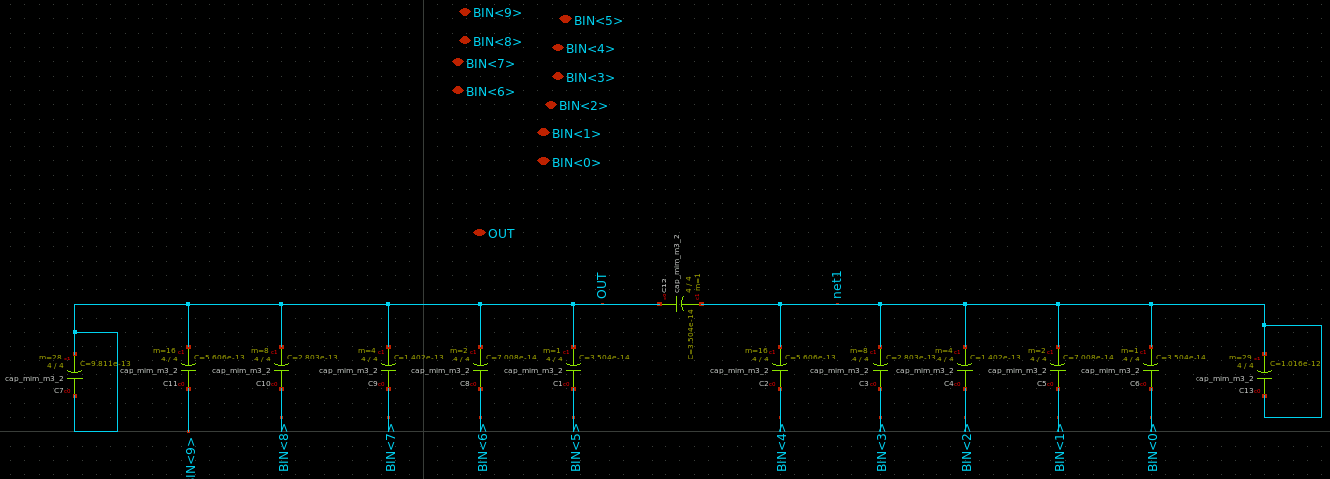
Capacitor-Bank Schematic
The DAC block of the SAR_ADC is implemented by using a binary-weighted capacitor array.
To reduce chip area, a split cap bank has been used.

Slide 19
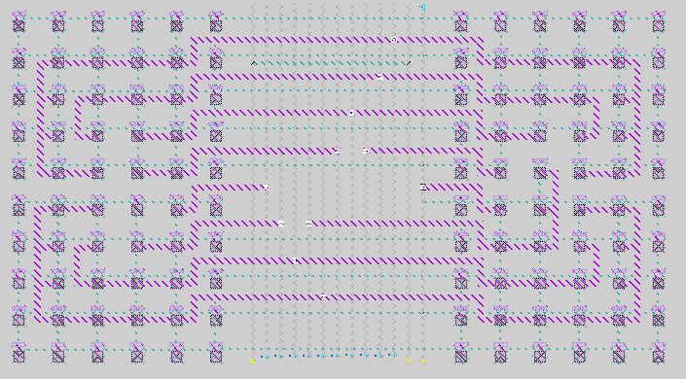
Capacitor-Bank Layout
Cap-Bank layout using MiM-Cap
In the split-cap bank, a binary-weighted capacitor array is divided into two smaller binary-weighted capacitor arrays.

Slide 20
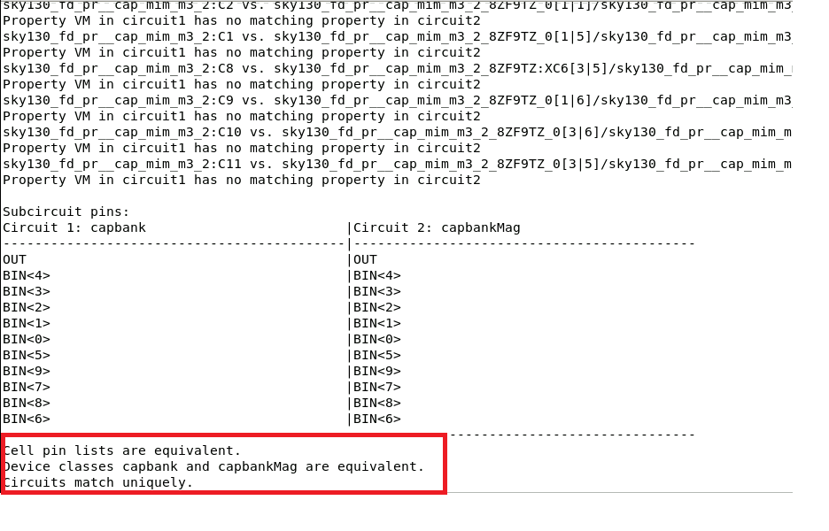
Capacitor-Bank LVS

Slide 21
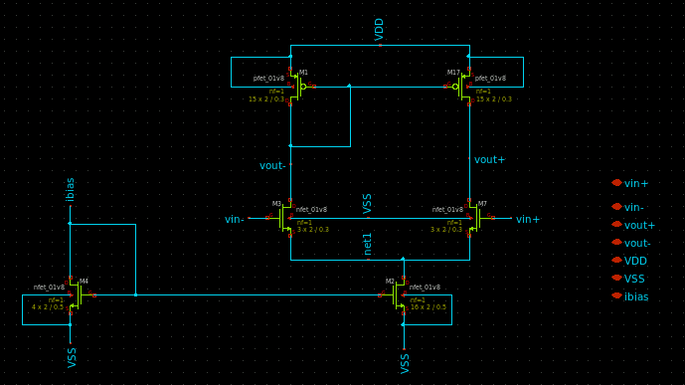
Pre-Amplifier Schematic
We need a pre-amplifier to improve the performance of StrongARM Latch by providing shielding from kickback noise.

Slide 22
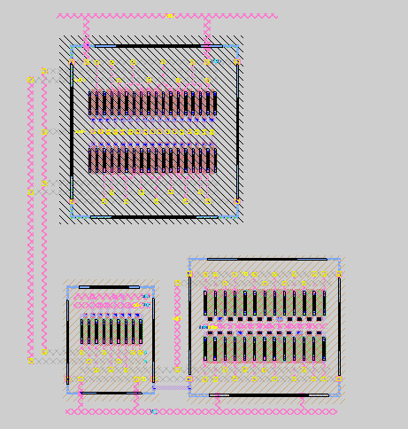
Pre-Amplifier Layout

Slide 23
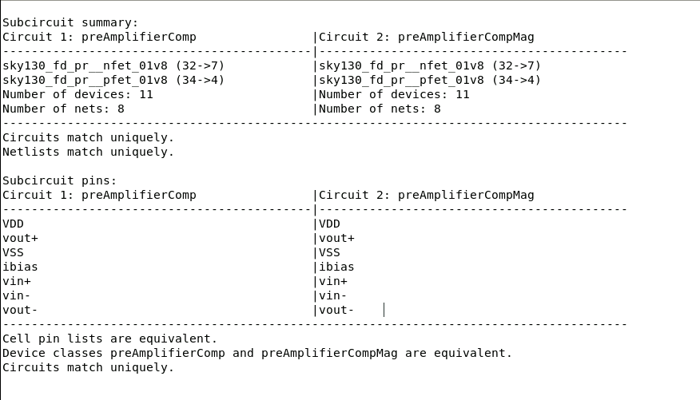
Pre-Amplifier LVS

Slide 24
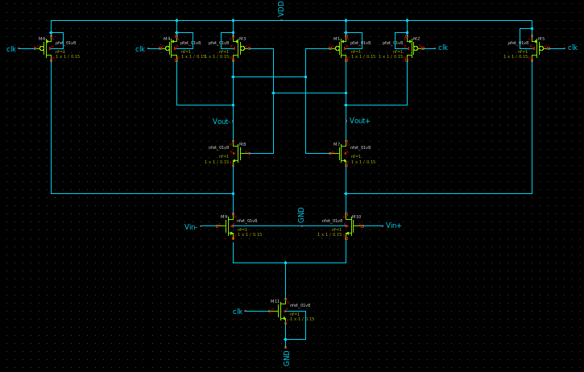
StrongARM Latch Comparator Schematic

Slide 25
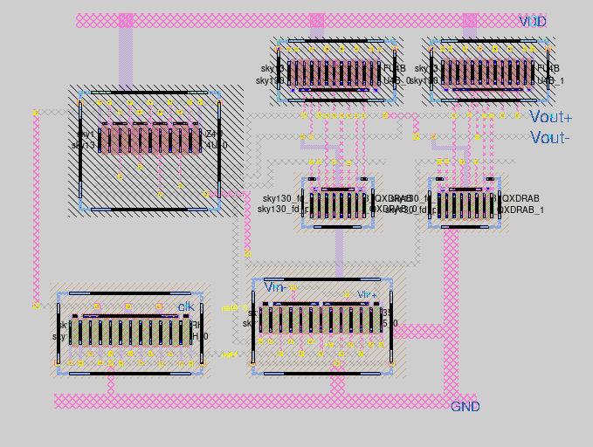
StrongARM Latch Comparator Layout

Slide 26
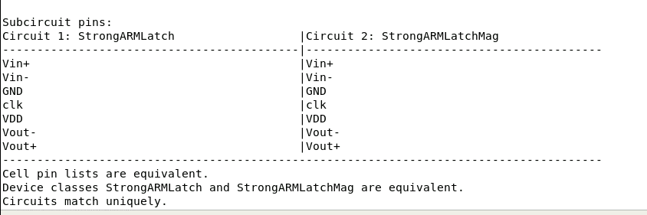
StrongARM Latch LVS

Slide 27
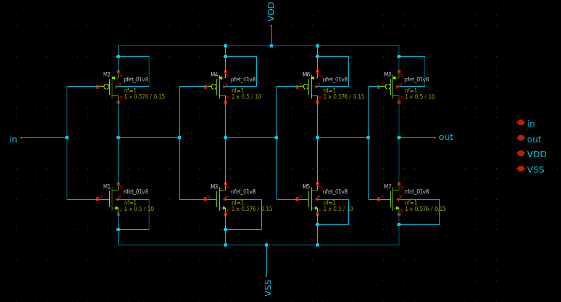
DelayBuffer Schematic
Usually, the decision from the latch is delayed; hence, we apply a delay buffer block before the SARLogic to capture the correct time.

Slide 28
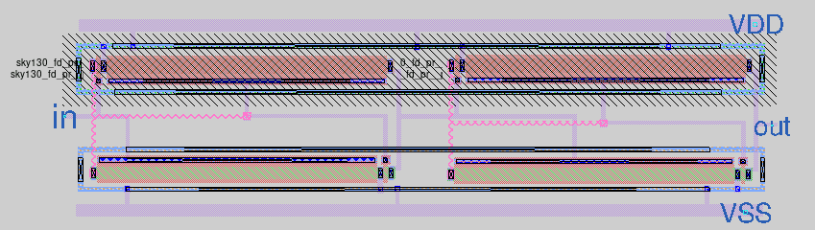
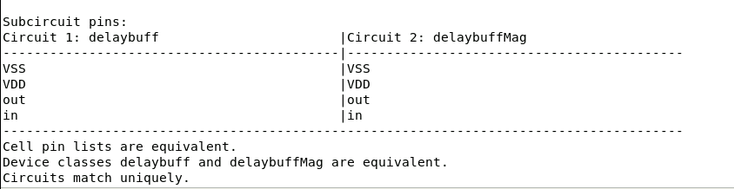
DelayBuffer Layout and LVS

Slide 29
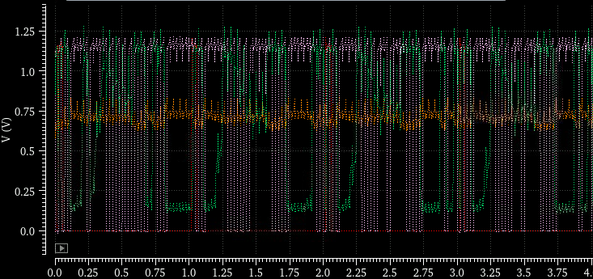
SAR_ADC Simulation
When the comparator output is 1, it means the value in the comparator negative terminal is less than the half of the reference voltage (Vref/2).
When the comparator output is 0, it means the value in the comparator negative terminal is more than the half of the reference voltage (Vref/2).

Slide 30
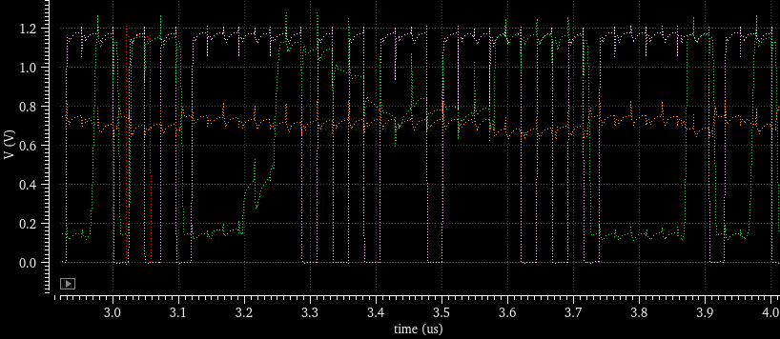
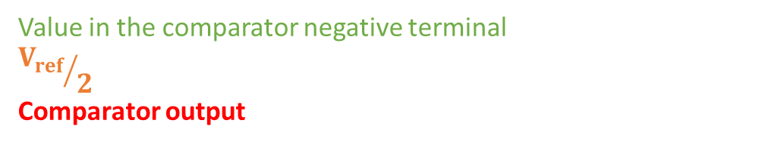
SAR_ADC Simulation
Value in the comparator negative terminal
$${V_{ref}}/2$$
Comparator output

Slide 31

SARLogic
RTL Simulation and then, extracting the GDS file.

Slide 32
Digital part
Digital Interface (DI)
Digital Interface (DI) is the interface between the DROIC array and the vexRISCV processor.
It has all the necessary logic to control DROIC circuity and communicate with the management area.
In addition to a controller it has a FIFO to be used for capturing/queuing DROIC samples then to be sent to the vexRISCV for further processing.

Slide 33
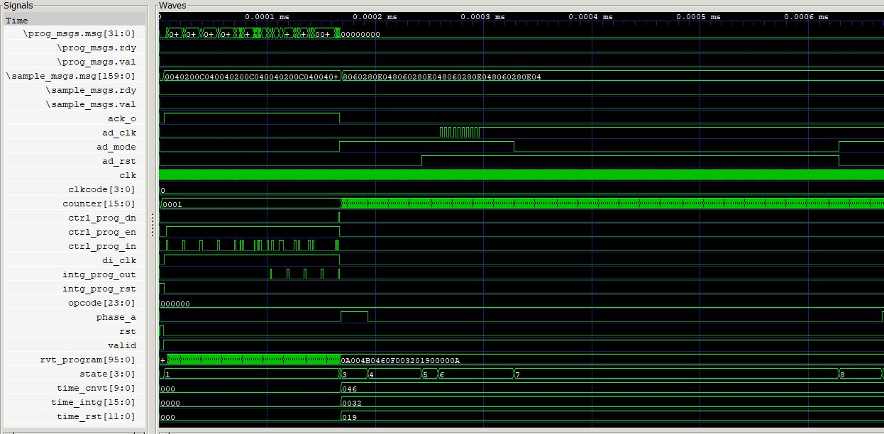
Digital Interface (DI)- DI Controller for the simulations DI gets gets its program over a wishbone port

Slide 34
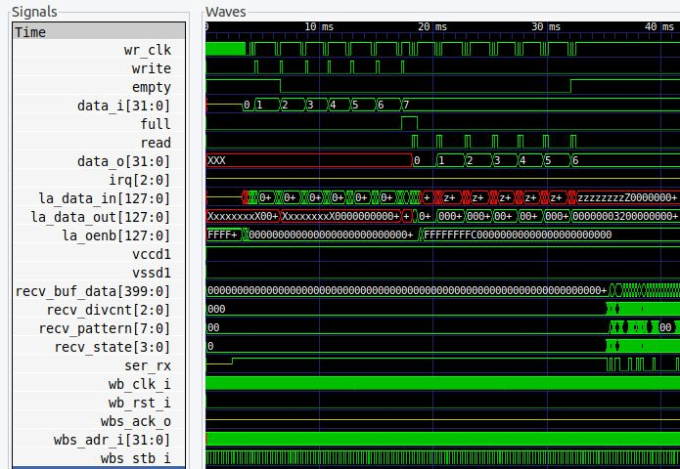
Digital Interface (DI)- FIFO for the simulations inputs & outputs are drawn from the Logic Analyzer

Slide 35
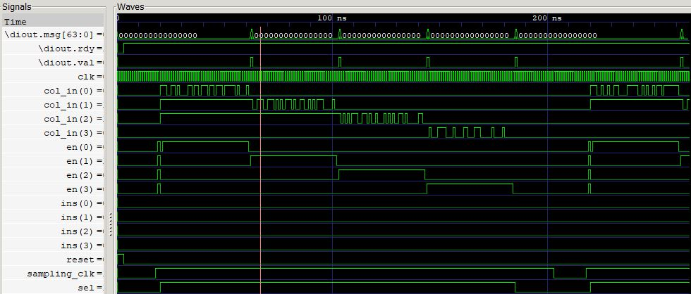
Digital Interface (DI)- TOP

Slide 36
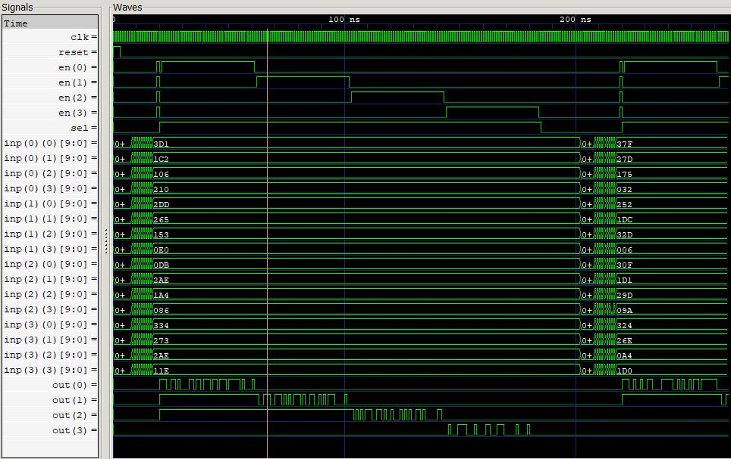
DROIC (4*4) Modeling

Slide 37
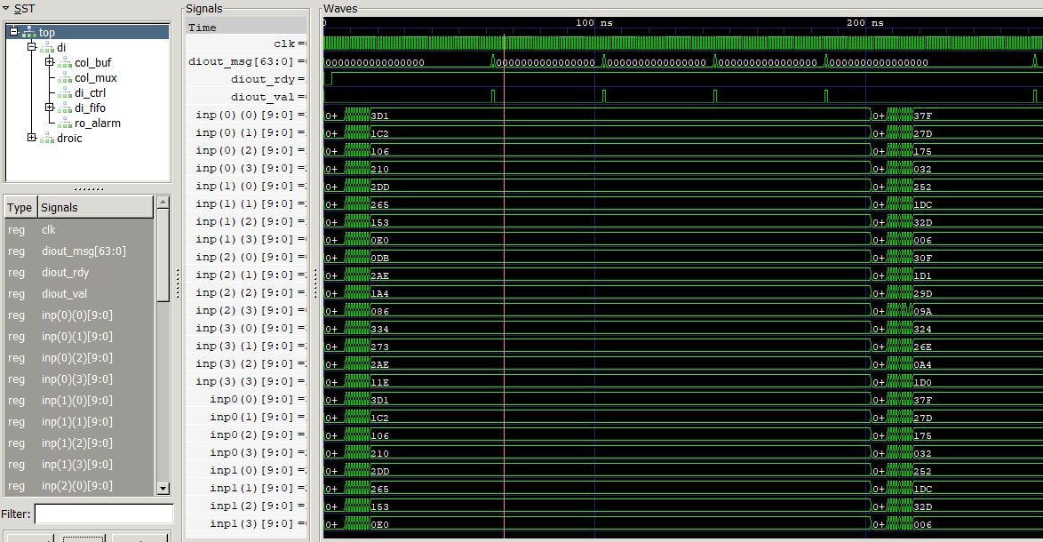
System on Chip (SeqSoC)- DI & DROIC

Slide 38
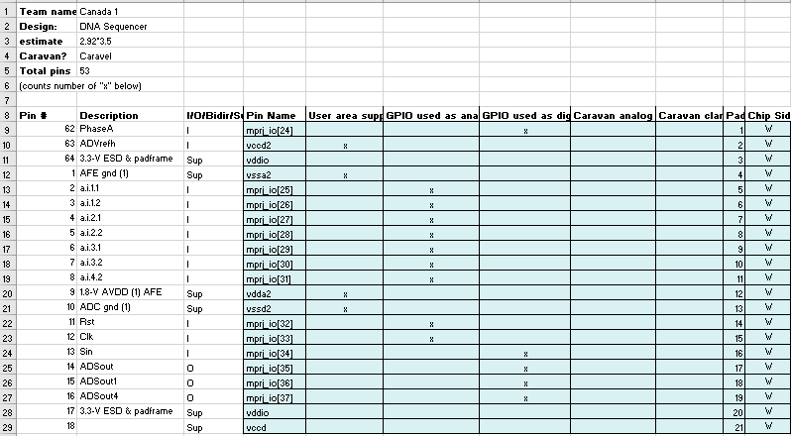
Pin List and Area Estimate
Estimated Area:
2.92*3.5
Total Pins:
53

Slide 39
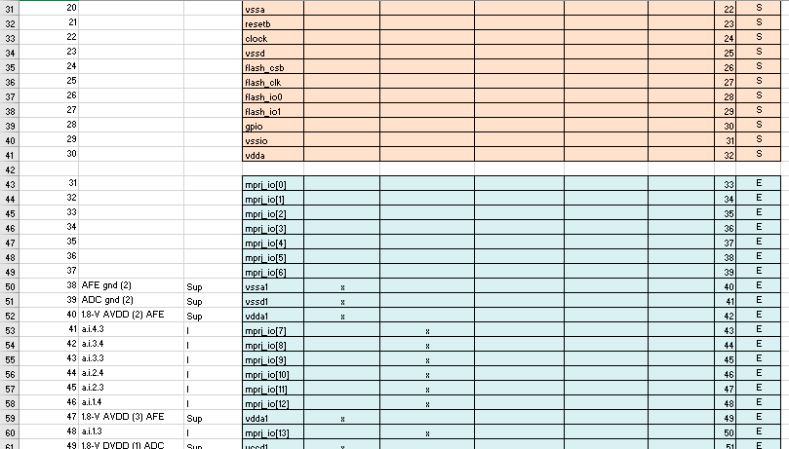
Pin List and Area Estimate

Slide 40
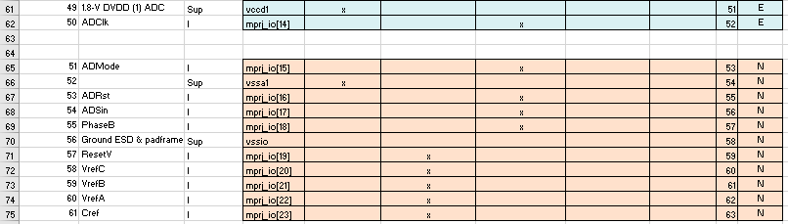
Pin List and Area Estimate

Slide 41
Progress Summary
Circuit Block | Design Status | To Do
AFE Layout | Mostly has been done | Complete the Layout
AFE LVS | Mostly will be done by the next week | Complete LVS
SAR_ADC Simulation | Done | -
SAR_ADC Layout | Mostly has been done | Complete the Layout
SAR_ADC LVS | Mostly will be done by the next week | Complete LVS
Digital Part | Ongoing
One Pixel | Ongoing | Populating all the layout of one pixel

Slide 42
Project Milestone
Tasks | Target Deadline
AFE Layout | End of October
AFE LVS | End of October
SAR_ADC Simulation | End of October
SAR_ADC Layout | End of October
SAR_ADC LVS | End of October
Digital Part | End of October
One pixel | End of October
16 pixel | Till Deadline

Slide 43
References
Dawji, Y., et al., A Scalable Discrete-Time Integrated CMOS Readout Array for Nanopore Based DNA Sequencing. IEEE Access, 2021. 9: p. 155543-155554.
J. Um, Y. Kim, E. Song, J. Sim and H. Park, "A Digital-Domain Calibration of Split-Capacitor DAC for a Differential SAR ADC Without Additional Analog Circuits," in IEEE Transactions on Circuits and Systems I: Regular Papers, vol. 60, no. 11, pp. 2845-2856, Nov. 2013, doi: 10.1109/TCSI.2013.2252475.

Slide 44
Thank you

